Slide 1

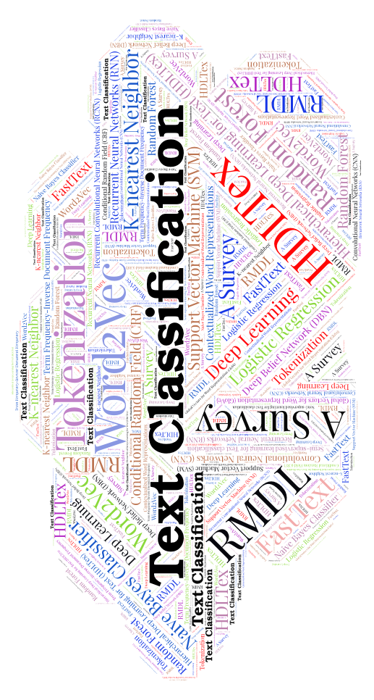
EDA: Easy Data Augmentation Techniques for Boosting Performance on Text Classification Tasks
Presenter: Fatemeh Sadat Rezvaninejad
97722086

Slide 2
01
03
INTRODUCTION
02
IMAGE AUGMENTATION
AUGMENTATION
04
05
TEXT AUGMENTATION
EDA AUGMENTATION

Slide 3
INTRODUCTION
Having a large dataset is crucial for performance.
Data Augmentation:
                Image
                Text EDA Approach
Notes:
for the performance of the deep learning model. However, we can improve the performance of the model by augmenting the data we already have

Slide 4
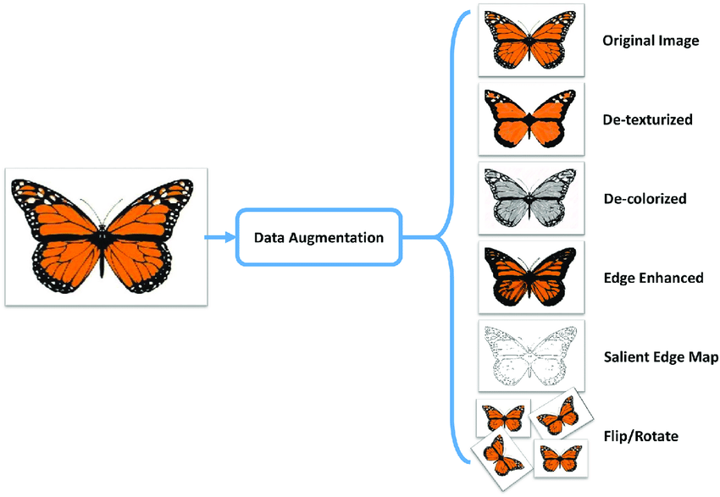
Augmentation
Data augmentation means increasing the number of data points.
The more the data ML models are better.

Slide 5

Benefits of Data Augmentation
● Technique to increase the amount of relevant data
● More data usually means better accuracy
● Very useful when you have small training datasets
● Reducing overfitting
● More robust models
Notes:
Data augmentation can be applied to any form of data

Slide 6
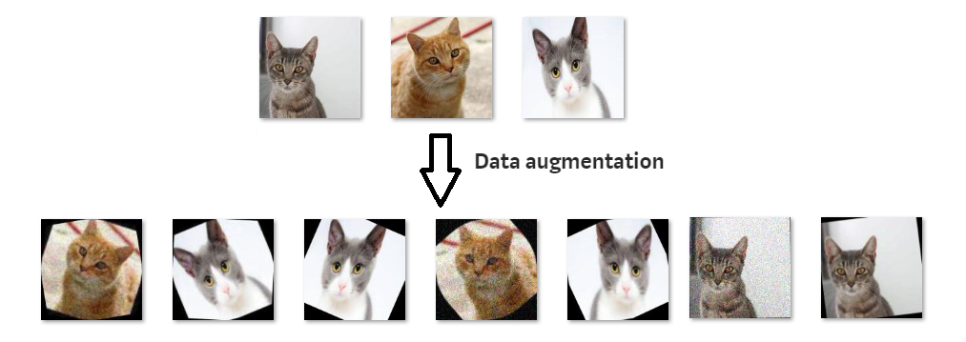
IMAGE
Data Augmentation is popular in computer vision
Notes:
○ Images are shifted, zoomed in/out, rotated, flipped, distorted, or shaded with a hue [1]
There are many ways to augment data. In images, you can rotate the original image, change lighting conditions, crop it differently, so for one image yo can generate different sub-samples. This way you can reduce overfitting your classifier^{[1]}.

Slide 7

TEXT
In natural language processing (NLP) field, it is hard to augmenting text due to high complexity of language
Notes:
. Not every word we can replace it by others such as a, an, the. Also, not every word has synonym. Even changing a word, the context will be totally difference. On the other hand, generating augmented image in computer vision area is relative easier. Even introducing noise or cropping out portion of image, model can still classify the image.

Slide 8
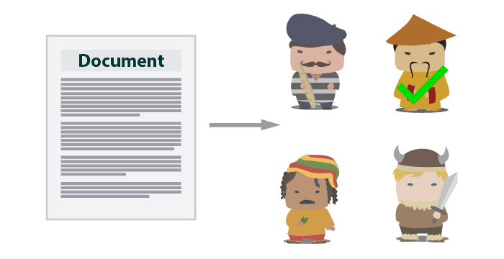

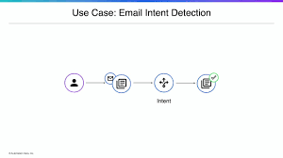
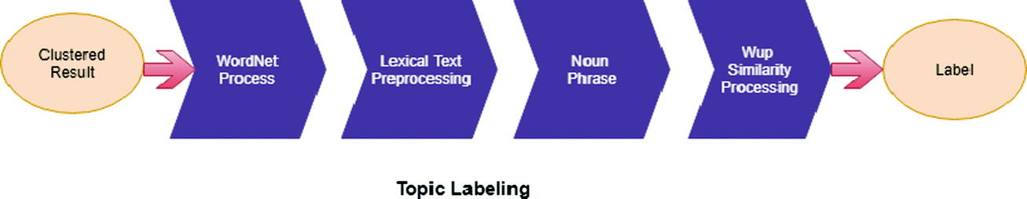
Language Detection
Sentiment Analysis
Topic Labeling
Intent Detection
Tasks for Text

Slide 9
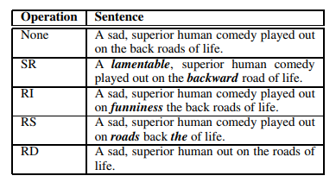
EDA
Synonym Replacement(SR)
Random Insertion(RI)
Random Swap(RS)
Random Deletion(RD)
Number of words that should change
n=αl

Slide 10

ALTERNATIVE RESOURCES
EDA is more helpful for smaller datasets
Model | Training Set Size
 | 500 | 2,000 | 5,000 | full set
RNN | 75.3 | 83.7 | 86.1 | 87.4
+EDA | 79.1 | 84.4 | 87.3 | 88.3
CNN | 78.6 | 85.6 | 87.7 | 88.3
+EDA | 80.7 | 86.4 | 88.3 | 88.8
Average | 76.9 | 84.6 | 86.9 | 87.8
+EDA | 79.9 | 85.4 | 87.8 | 88.6
1. SST-2
2. CR
3. SUBJ
4. TREC
5. PC
Notes:
SST-2: Stanford Sentiment Treebank CR: customer reviews (3) SUBJ: subjectivity/objectivity dataset TREC: question type dataset PC: Pro-Con dataset
3,0.8

Slide 11
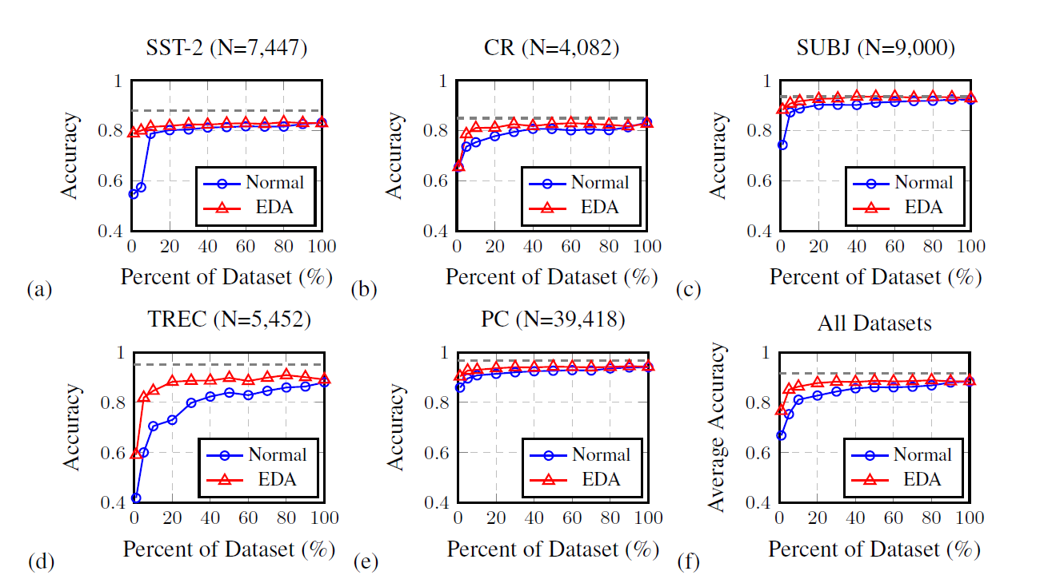
EDA effects on Datasets
Notes:
Eda-88.6 50%

Slide 12
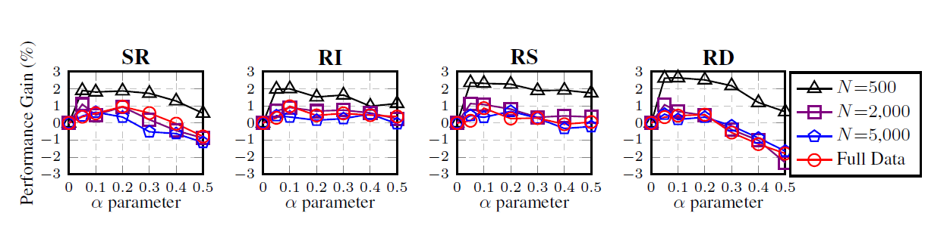
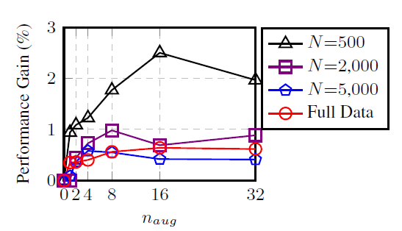
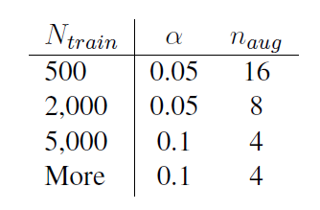
Notes:
Alpha koochik ,alpha taesir nmizare, alpha<=0.2,alpha>=0.3 shuffling

Slide 13
When Training data is not
enough, Augmentation is useful.
EDA presents a simple way of
augmentation for text which
improves performance.
SUMMARY

Slide 14

Wei, J.W. and Zou, K., 2019. Eda: Easy data augmentation techniques for boosting performance on text classification tasks. arXiv preprint arXiv:1901.11196.
https://www.quora.com/What-does-the-term-data-augmentation-mean-in-the-context-of-Machine-Learning
https://towardsdatascience.com/data-augmentation-experimentation-3e274504f04b
https://towardsdatascience.com/machinex-image-data-augmentation-using-keras-b459ef87cd22

Slide 15

THANKS!
Any questions?
Rezvaninejad_f@comp.iust.ac.ircomp.iust.ac.ir

